Slide 1

Java: Advanced GUI Applications
CS 469 / CS 569: Special Topics in Computer Science: Human-Computer Interaction
Dr. Mohammed Ayoub Alaoui Mhamdi
Bishop's University
Sherbrooke, Qc, Canada
malaoui@ubishops.ca

Slide 2
Chapter Topics (1 of 2)
This chapter discusses the following topics:
The Swing and AWT Class Hierarchy
Read-Only Text Fields
Lists
Combo Boxes
Displaying Images in Labels and Buttons
Mnemonics and Tool Tips

Slide 3
Chapter Topics (2 of 2)
This chapter discusses the following main topics:
File Choosers and Color Choosers
Menus
More about Text Components: Text Areas and Fonts
Sliders
Look and Feel

Slide 4
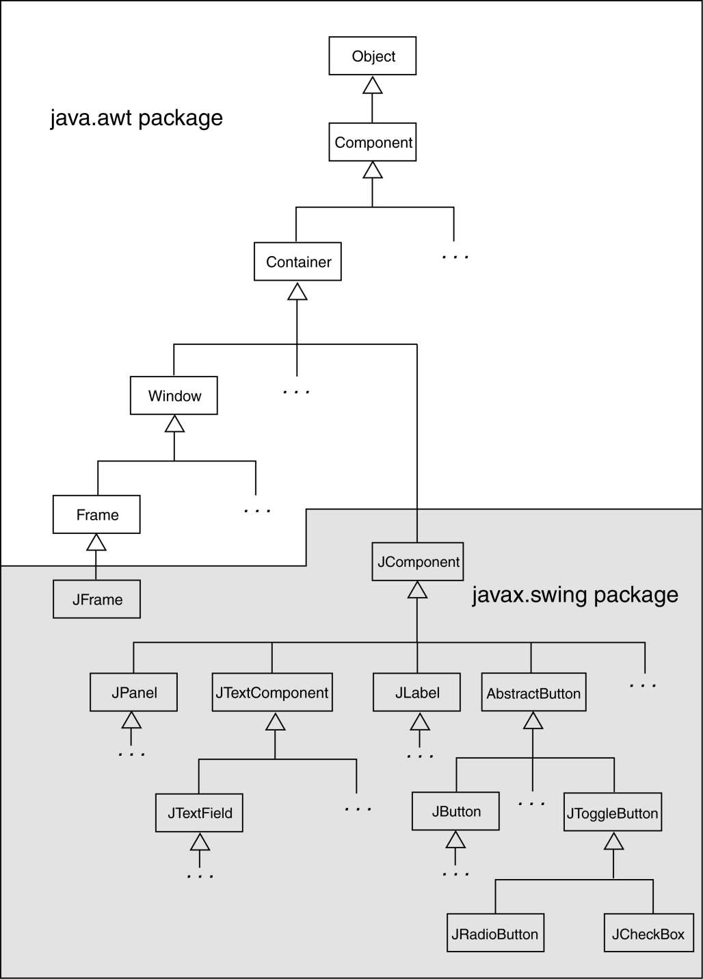
The Swing and AWT Class Hierarchy

Slide 5
Read Only Text Fields
Read only text fields are a different way to use the JTextField component.
The JTextField component has a method named setEditable:
setEditable(boolean editable)
By default a text field is editable.
The setEditable method must be called and passed false to make the field read-only.

Slide 6
Lists
A list is a component that displays a list of items and allows the user to select items from the list.
The JList component is used for creating lists.
When an instance of the JList class is created, an array of objects is passed to the constructor.
JList (Object[] array)
The JList component uses the array to create the list of items.
String[] names = { "Bill", "Geri", "Greg", "Jean", "Kirk", "Phillip", "Susan" };
JList nameList = new JList(names);

Slide 7
List Selection Modes (1 of 3)
The JList component can operate in any of the following selection modes:
Single Selection Mode - Only one item can be selected at a time.
Single Interval Selection Mode - Multiple items can be selected, but they must be in a single interval. An interval is a set of contiguous items.
Multiple Interval Selection Mode - In this mode multiple items may be selected with no restrictions.
This is the default selection mode.

Slide 8
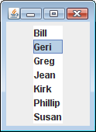
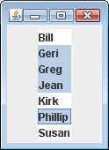
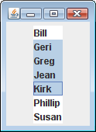
List Selection Modes (2 of 3)
Single selection mode allows
only one item to be selected
at a time.
Multiple interval selection mode allows multiple items to be selected with no restrictions.
Single interval selection mode allows
a single interval of contiguous items
to be selected.

Slide 9
List Selection Modes (3 of 3)
You change a JList component’s selection mode with the setSelectionMode method.
The method accepts an int argument that determines the selection mode:
ListSelectionModel.SINGLE_SELECTION
ListSelectionModel.SINGLE_INTERVAL_SELECTION
ListSelectionModel.MULTIPLE_INTERVAL_SELECTION
Example:
nameList.setSelectionMode(
ListSelectionModel.SINGLE_SELECTION);

Slide 10
List Events (1 of 2)
When an item in a JList object is selected it generates a list selection event.
The event is handled by an instance of a list selection listener class, which must meet the following requirements:
It must implement the ListSelectionListener interface.
It must have a method named valueChanged. This method must take an argument of the ListSelectionEvent type.
Use the addListSelectionListener method of the JList class to register the instance of the list selection listener class with the list object.

Slide 11
List Events (2 of 2)
When the JList component generates an event:
it automatically executes the valueChanged method of the list selection listener object
It passes the event object as an argument.

Slide 12
Retrieving Selected Items (1 of 3)
You may use:
getSelectedValue or
getSelectedIndex
to determine which item in a list is currently selected.
getSelectedValue returns a reference to the item that is currently selected.
String selectedName;
selectedName = (String)nameList.getSelectedValue();
The return value must be cast to String is required in order to store it in the selectedName variable.
If no item in the list is selected, the method returns null.

Slide 13
Retrieving Selected Items (2 of 3)
The getSelectedIndex method returns the index of the selected item, or –1 if no item is selected.
Internally, the items that are stored in a list are numbered (similar to an array).
Each item’s number is called its index.
The first item has the index 0.
You can use the index of the selected item to retrieve the item from an array.
String[] names = { "Bill", "Geri", "Greg", "Jean", "Kirk", "Phillip", "Susan" };
JList nameList = new JList(names);

Slide 14
Retrieving Selected Items (3 of 3)
This code could be used to determine the selected item:
int index;
String selectedName;
index = nameList.getSelectedIndex();
if (index != -1)
selectedName = names[index];
Example: ListWindow.java

Slide 15
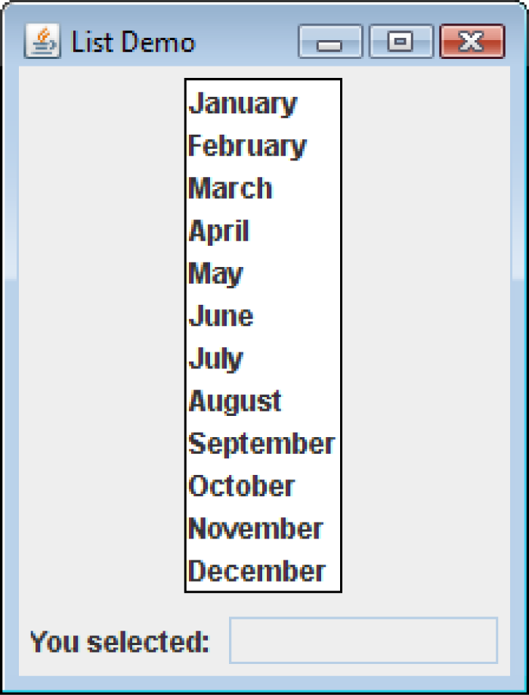
Bordered Lists
The setBorder method can be used to draw a border around a JList.
monthList.setBorder(
BorderFactory.createLineBorder(Color.black,1));

Slide 16
Adding A Scroll Bar To a List (1 of 5)
By default, a list component is large enough to display all of the items it contains.
Sometimes a list component contains too many items to be displayed at once.
Most GUI applications display a scroll bar on list components that contain a large number of items.
List components do not automatically display a scroll bar.

Slide 17
Adding A Scroll Bar To a List (2 of 5)
To display a scroll bar on a list component, follow these general steps.
Set the number of visible rows for the list component.
Create a scroll pane object and add the list component to it.
Add the scroll pane object to any other containers, such as panels.
For this list:
String[] names = { "Bill", "Geri", "Greg", "Jean", "Kirk", "Phillip", "Susan" };
JList nameList = new JList(names);

Slide 18
Adding A Scroll Bar To a List (3 of 5)
Establish the size of the list component.
nameList.setVisibleRowCount(3);
Create a scroll pane object and add the list component to it.
A scroll pane object is a container that displays scroll bars on any component it contains.
The JScrollPane class to create a scroll pane object.
We pass the object that we wish to add to the scroll pane as an argument to the JScrollPane constructor.
JScrollPane scrollPane = new
JScrollPane(nameList);

Slide 19
Adding A Scroll Bar To a List (4 of 5)
Add the scroll pane object to any other containers that are necessary for our GUI.
JPanel panel = new JPanel();
panel.add(scrollPane);
add(panel);
When the list component is displayed, it will appear with:
Three items showing at a time and
scroll bars:

Slide 20
Adding A Scroll Bar To a List (5 of 5)
By default, JList components added to a JScrollPane object only display a scroll bar if there are more items in the list than there are visible rows.
When a JList component is added to a JScrollPane object, a border will automatically appear around the list.
Example: ListWindowWithScroll.java

Slide 21
Adding Items to an Existing List (1 of 2)
The setListData method allows the adding of items in an existing JList component.
void setListData(Object[] data)
This replaces any items that are currently displayed in the component.
This can be used to add items to an empty list.

Slide 22
Adding Items to an Existing List (2 of 2)
You can create an empty list by using the JList component’s no-parameter constructor:
JList nameList = new JList();
Items can be added to the list:
String[] names = { "Bill", "Geri", "Greg", "Jean", "Kirk", "Phillip", "Susan" };
nameList.setListData(names);

Slide 23
Single Interval Selection Mode (1 of 2)
A list is set to single interval selection mode by passing the constant
ListSelectionModel.SINGLE_INTERVAL_SELECTION
to the component’s setSelectionMode method.
An interval is a set of contiguous items.
The user selects:
the first item in the interval by clicking on it
the last item by holding the Shift key while clicking on it.
All of the items that appear in the list from the first item through the last item are selected.

Slide 24
Single Interval Selection Mode (2 of 2)
The getSelectedValue method returns the first item in the selected interval.
The getSelectedIndex method returns the index of the first item in the selected interval.
To get the entire selected interval, use the getSelectedValues method.
This method returns an array of objects, which are the items in the selected interval.
The getSelectedIndices method returns an array of int values that are the indices of all the selected items in the list.

Slide 25
Multiple Interval Selection Mode (1 of 3)
Set multiple interval selection mode by passing the constant
ListSelectionModel.MULTIPLE_INTERVAL_SELECTION
to the component’s setSelectionMode method.
In multiple interval selection mode:
multiple items can be selected
the items do not have to be in the same interval.
In multiple interval selection mode the user can select single items or intervals.

Slide 26
Multiple Interval Selection Mode (2 of 3)
The user holds down the Ctrl key while clicking on an item
it selects the item without deselecting other items.
The getSelectedValue method returns the first selected item.
The getSelectedIndex method returns the index of the first selected item.
The getSelectedValues method returns an array of objects containing the items that are selected.
The getSelectedIndices method returns an int array containing the indices of the selected items.

Slide 27
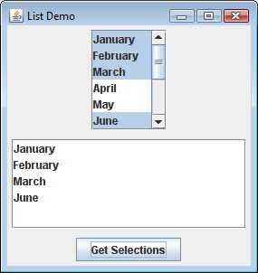
Multiple Interval Selection Mode (3 of 3)
Example: MultipleIntervalSelection.java

Slide 28

Combo Boxes (1 of 2)
A combo box presents a drop-down list of items that the user may select from.
The JComboBox class is used to create a combo box.
Pass an array of objects that are to be displayed as the items in the drop-down list to the constructor.
String[] names = { "Bill", "Geri", "Greg", "Jean", "Kirk", "Phillip", "Susan" };
JComboBox nameBox = new JComboBox(names);
When displayed, the combo box created by this code will initially appear as the button:

Slide 29
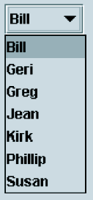
Combo Boxes (2 of 2)
The button displays the item that is currently selected.
The first item in the list is automatically selected when the combo box is displayed.
When the user clicks on the button, the drop-down list appears and the user may select another item.

Slide 30
Combo Box Events
When an item in a JComboBox object is selected, it generates an action event.
Handle action events with an action event listener class, which must have an actionPerformed method.
When the user selects an item in a combo box, the combo box executes its action event listener’s actionPerformed method, passing an ActionEvent object as an argument.

Slide 31
Retrieving Selected Items (1 of 3)
There are two methods in the JComboBox class that can be used to determine which item in a list is currently selected:
getSelectedItem
getSelectedIndex
The getSelectedItem method returns a reference to the item that is currently selected.
String selectedName;
selectedName = (String) nameBox.getSelectedItem();
getSelectedItem returns an Object reference so we cast the return value to a String.

Slide 32
Retrieving Selected Items (2 of 3)
The getSelectedIndex method returns the index of the selected item.
String[] names = { "Bill", "Geri", "Greg", "Jean", "Kirk", "Phillip", "Susan" };
JComboBox nameBox = new JComboBox(names);
Get the selected item from the names array:
int index;
String selectedName;
index = nameBox.getSelectedIndex();
selectedName = names[index];

Slide 33
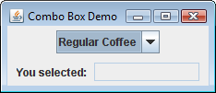
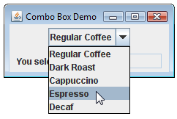
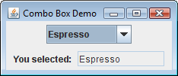
Retrieving Selected Items (3 of 3)
Example:
ComboBoxWindow.java

Slide 34
Editable Combo Boxes (1 of 3)
There are two types of combo boxes:
uneditable – allows the user to only select items from its list.
editable – combines a text field and a list.
It allows the selection of items from the list
allows the user to type input into the text field
The setEditable method sets the edit mode for the component.
String[] names = { "Bill", "Geri", "Greg", "Jean", "Kirk", "Phillip", "Susan" };
JComboBox nameBox = new JComboBox(names);
nameBox.setEditable(true);

Slide 35
Editable Combo Boxes (2 of 3)
An editable combo box appears as a text field with a small button displaying an arrow joining it.
When the user clicks on the button, the drop-down list appears as shown in the center of the figure.
The user may:
select an item from the list.
type a value into the text field.
The user is not restricted to the values that appear in the list, and may type any input into the text field.

Slide 36

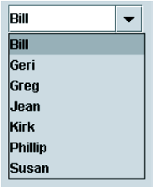

Editable Combo Boxes (3 of 3)
Note that Sharon is not in the list.

Slide 37
Displaying Images in Labels and Buttons (1 of 5)
Labels can display text, an image, or both.
To display an image, create an instance of the ImageIcon class, which reads the image file.
The constructor accepts the name of an image file.
The supported file types are JPEG, GIF, and PNG.
The name can also contain path information.
ImageIcon image = new ImageIcon("Smiley.gif");
or
ImageIcon image = new ImageIcon(
"C:\\Chapter 12\\Images\\Smiley.gif");

Slide 38
Displaying Images in Labels and Buttons (2 of 5)
Display the image in a label by passing the ImageIcon object as an argument to the JLabel constructor.
JLabel(Icon image)
The argument passed can be an ImageIcon object or any object that implements the Icon interface.
ImageIcon image = new ImageIcon("Smiley.gif");
JLabel label = new JLabel(image);
or
JLabel label = new JLabel("Have a nice day!");
label.setIcon(image);

Slide 39
Displaying Images in Labels and Buttons (3 of 5)
Text is displayed to the right of images by default.
Text alignment can be modified by passing one of the following to an overloaded constructor:
SwingConstants.LEFT
SwingConstants.CENTER
SwingConstants.RIGHT
Example:
ImageIcon image = new ImageIcon("Smiley.gif");
JLabel label = new JLabel("Have a nice day!",
image,
SwingConstants.RIGHT);

Slide 40
Displaying Images in Labels and Buttons (4 of 5)
Creating a button with an image is similar to that of creating a label with an image.
ImageIcon image = new ImageIcon("Smiley.gif");
JButton button = new JButton(image);
To create a button with an image and text:
ImageIcon image = new ImageIcon("Smiley.gif");
JButton button = new JButton(
"Have a nice day!", image);
button.setIcon(image);

Slide 41
Displaying Images in Labels and Buttons (5 of 5)
To add an image to an existing button:
JButton button = new JButton(
"Have a nice day!");
ImageIcon image = new ImageIcon("Smiley.gif");
button.setIcon(image);
You are not limited to small graphical icons when placing images in labels or buttons.
Example: MyCatImage.java

Slide 42
Mnemonics (1 of 4)
A mnemonic is a key that you press in combination with the Alt key to quickly access a component.
These are sometimes referred to as hot keys.
A hot key is assigned to a component through the component’s setMnemonic method
The argument passed to the method is an integer code that represents the key you wish to assign.

Slide 43
Mnemonics (2 of 4)
The key codes are predefined constants in the KeyEvent class (java.awt.event package).
These constants take the form:
KeyEvent.VK_x, where x is a key on the keyboard.
The letters VK in the constants stand for “virtual key”.
To assign the A key as a mnemonic, use KeyEvent.VK_A.
Example:
JButton exitButton = new JButton("Exit");
exitButton.setMnemonic(KeyEvent.VK_X);

Slide 44
Mnemonics (3 of 4)
If the letter is in the component’s text, the first occurrence of that letter will appear underlined.
If the letter does not appear in the component’s text, then no letter will appear underlined.

Slide 45
Mnemonics (4 of 4)
You can also assign mnemonics to radio buttons and check boxes:
JRadioButton rb1 = new
JRadioButton("Breakfast");
rb1.setMnemonic(KeyEvent.VK_B);
JRadioButton rb2 = new JRadioButton("Lunch");
rb2.setMnemonic(KeyEvent.VK_L);
JCheckBox cb1 = new JCheckBox("Monday");
cb1.setMnemonic(KeyEvent.VK_M);
JCheckBox cb2 = new JCheckBox("Wednesday");
cb2.setMnemonic(KeyEvent.VK_W);

Slide 46
Tool Tips (1 of 2)
A tool tip is text that is displayed in a small box when the mouse is held over a component.
The box usually gives a short description of what the component does.
Most GUI applications use tool tips as concise help to the user.

Slide 47
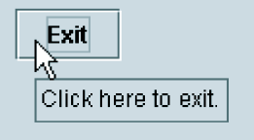

Tool Tips (2 of 2)
Assign a tool tip to a component with the setToolTipText method.
JButton exitButton = new JButton("Exit");
exitButton.setMnemonic(KeyEvent.VK_X);
exitButton.setToolTipText(
"Click here to exit.");
Note the mnemonic x.
Tool tip

Slide 48
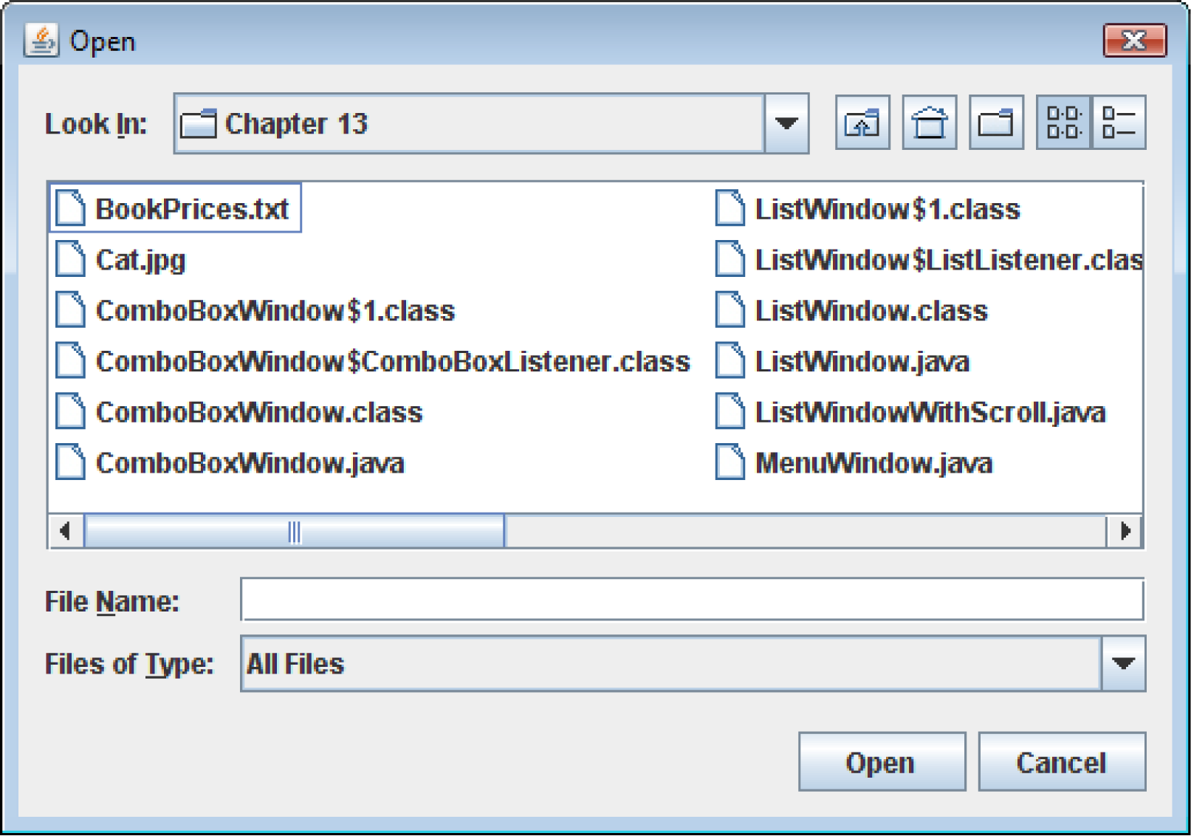
File Choosers (1 of 7)
A file chooser is a specialized dialog box that allows the user to browse for a file and select it.

Slide 49
File Choosers (2 of 7)
Create an instance of the JFileChooser class to display a file chooser dialog box.
Two of the constructors have the form:
JFileChooser()
JFileChooser(String path)
The first constructor shown takes no arguments and uses the default directory as the starting point for all of its dialog boxes.
The second constructor takes a String argument containing a valid path. This path will be the starting point for the object’s dialog boxes.

Slide 50
File Choosers (3 of 7)
A JFileChooser object can display two types of predefined dialog boxes:
open file dialog box – lets the user browse for an existing file to open.
a save file dialog box – lest the user browse to a location to save a file.

Slide 51
File Choosers (4 of 7)
To display an open file dialog box, use the showOpenDialog method.
General format:
int showOpenDialog(Component parent)
The argument can be null or a reference to a component.
If null is passed, the dialog box is normally centered in the screen.
If you pass a reference to a component the dialog box is displayed over the component.

Slide 52
File Choosers (5 of 7)
To display a save file dialog box, use the showSaveDialog method.
General format:
int showSaveDialog(Component parent)
The argument can be either null or a reference to a component.
Both methods return an integer that indicates the action taken by the user to close the dialog box.

Slide 53
File Choosers (6 of 7)
You can compare the return value to one of the following constants:
JFileChooser.CANCEL_OPTION – indicates that the user clicked on the Cancel button.
JFileChooser.APPROVE_OPTION – indicates that the user clicked on the OK button.
JFileChooser.ERROR_OPTION – indicates that an error occurred, or the user clicked on the standard close button on the window to dismiss it.
If the user selected a file, use the getSelectedFile method to determine the file that was selected.
The getSelectedFile method returns a File object, which contains data about the selected file.

Slide 54
File Choosers (7 of 7)
Use the File object’s getPath method to get the path and file name as a String.
JFileChooser fileChooser = new JFileChooser();
int status = fileChooser.showOpenDialog(null);
if (status == JFileChooser.APPROVE_OPTION)
{
File selectedFile =
fileChooser.getSelectedFile();
String filename = selectedFile.getPath();
JOptionPane.showMessageDialog(null,
"You selected " + filename);
}

Slide 55
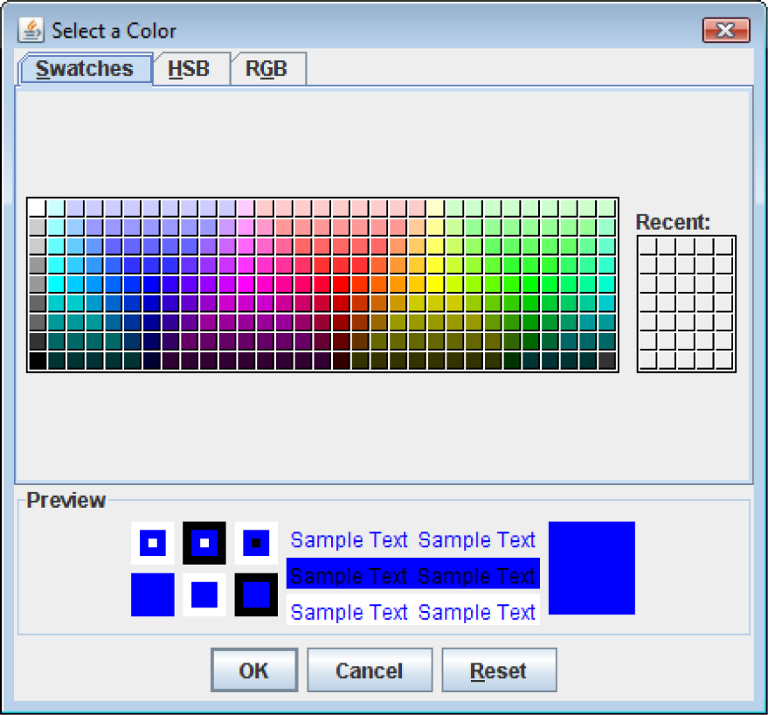
Color Choosers (1 of 4)
A color chooser is a specialized dialog box that allows the user to select a color from a predefined palette of colors.

Slide 56
Color Choosers (2 of 4)
By clicking the HSB tab you can select a color by specifying its hue, saturation, and brightness.
By clicking the RGB tab you can select a color by specifying its red, green, and blue components.
The JColorChooser class has a static method named showDialog, with the following general format:
Color showDialog(Component parent,
String title, Color initial)

Slide 57
Color Choosers (3 of 4)
If the first argument is null, the dialog box is normally centered in the screen.
If it is a reference to a component the dialog box is displayed over the component.
The second argument is the dialog title.
The third argument indicates the color that appears initially selected in the dialog box.
This method returns the color selected by the user.

Slide 58
Color Choosers (4 of 4)
Example:
JPanel panel = new JPanel();
Color selectedColor =
JColorChooser.showDialog(null,
"Select a Background Color",
Color.BLUE);
panel.setBackground(selectedColor);

Slide 59
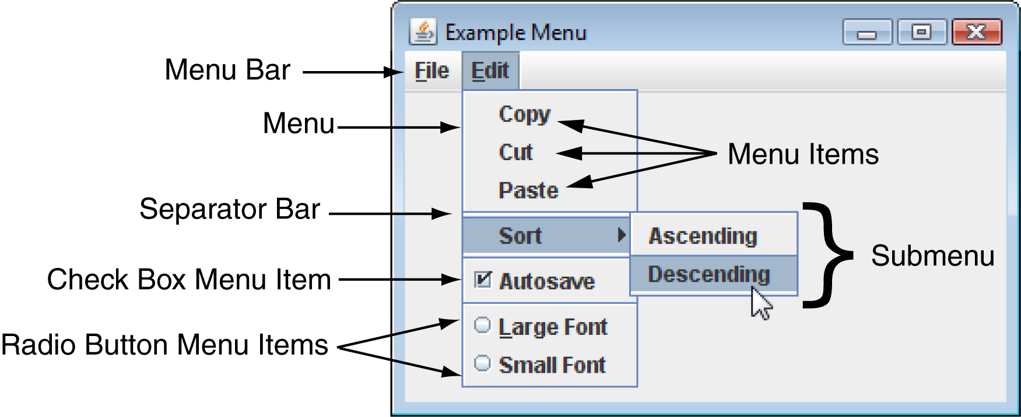
Menus
A menu system is a collection of commands organized in one or more drop-down menus.

Slide 60
Components of A Menu System
A menu system commonly consists of:
Menu Bar – A menu bar lists the names of one or menus.
Menu – A menu is a drop-down list of menu items.
Menu Item – A menu item can be selected by the user.
Check box menu item – A check box menu item appears with a small box beside it.
The item may be selected or deselected.
Radio button menu item – A radio button menu item may be selected or deselected.
Submenu – A menu within a menu is called a submenu.
Separator bar – A separator bar is a horizontal bar used to separate groups of items on a menu.

Slide 61
Menu Classes (1 of 2)
A menu system is constructed with the following classes:
JMenuBar – Used to create a menu bar.
A JMenuBar object can contain JMenu components.
JMenu – Used to create a menu. A JMenu component can contain:
JMenuItem, JCheckBoxMenuItem, and JRadioButtonMenuItem components,
as well as other JMenu components.
A submenu is a JMenu component that is inside another JMenu component.
JMenuItem – Used to create a regular menu item.
A JMenuItem component generates an action event when selected.

Slide 62
Menu Classes (2 of 2)
JCheckBoxMenuItem – Used to create a check box menu item.
The class’s isSelected method returns true if the item is selected, or false otherwise.
A JCheckBoxMenuItem component generates an action event when selected.
JRadioButtonMenuItem – Used to create a radio button menu item.
JRadioButtonMenuItem components can be grouped together in a ButtonGroup object so that only one of them can be selected at a time.
The class’s isSelected method returns true if the item is selected, or false otherwise.
A JRadioButtonMenuItem component generates an action event when selected.

Slide 63
Menu Example
Menu Example: MenuWindow.java

Slide 64
Text Areas (1 of 5)
The JTextField class is used to create text fields.
A text field is a component that allows the user to enter a single line of text.
A text area is like a text field that can accept multiple lines of input.
You use the JTextArea class to create a text area.
The general format of two of the class’s constructors:
JTextArea(int rows, int columns)
JTextArea(String text, int rows, int columns)

Slide 65
Text Areas (2 of 5)
The JTextArea class provides the getText and setText methods for getting and setting the text.
String userText = textInput.getText();
textInput.setText("Modified: " + userText);
JTextArea components do not automatically display scroll bars.
You must add a text area to a scroll pane.
JTextArea textInput = JTextArea(20, 40);
JScrollPane scrollPane = new
JScrollPane(textInput);

Slide 66
Text Areas (3 of 5)
The JScrollPane object displays both vertical and horizontal scroll bars on a text area.
By default, the scroll bars are not displayed until they are needed.
This behavior can be altered:
scrollPane.setHorizontalScrollBarPolicy(
JScrollPane.HORIZONTAL_SCROLLBAR_NEVER);
scrollPane.setVerticalScrollBarPolicy(
JScrollPane.VERTICAL_SCROLLBAR_ALWAYS);

Slide 67
Text Areas (4 of 5)
You can pass one of the following constants as an argument:
setHorizontalScrollBarPolicy
JScrollPane.HORIZONTAL_SCROLLBAR_AS_NEEDED.
JScrollPane.HORIZONTAL_SCROLLBAR_NEVER
JScrollPane.HORIZONTAL_SCROLLBAR_ALWAYS
setVericalScrollBarPolicy
JScrollPane.VERTICAL_SCROLLBAR_AS_NEEDED
JScrollPane.VERTICAL_SCROLLBAR_NEVER
JScrollPane.VERTICAL_SCROLLBAR_ALWAYS

Slide 68
Text Areas (5 of 5)
By default, JTextArea components do not perform line wrapping.
To enable line wrapping:
textInput.setLineWrap(true);
There are two different styles of line wrapping:
word wrapping – the line breaks always occur between words.
textInput.setWrapStyleWord(true);
character wrapping – lines are broken between characters (default mode).

Slide 69
Fonts (1 of 2)
Components display according to their font characteristics:
font – the name of the typeface
style – can be plain, bold, and/or italic
size – size of the text in points.
A component’s setFont method will change the appearance of the text in the component:
setFont (Font appearance)
A Font constructor takes three parameters:
Font(String fontName, int style, int size)

Slide 70
Fonts (2 of 2)
Java guarantees that you will have the fonts:
Dialog, DialogInput, Monospaced, SansSerif, and Serif.
There are three font styles:
Font.PLAIN, Font.BOLD, and Font.ITALIC.
Example:
label.setFont(new Font(
"Serif", Font.BOLD, 24));
Font styles can be combined adding them.
label.setFont(new Font(
"Serif", Font.BOLD + Font.ITALIC, 24));

Slide 71
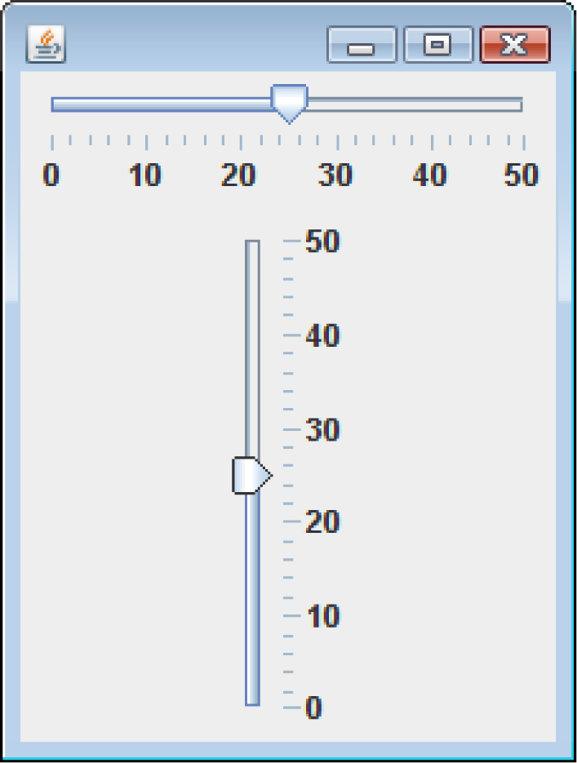
Sliders (1 of 6)
A slider is a component that allows the user to graphically adjust a number within a range.
Sliders are created from the JSlider class.
They display an image of a “slider knob” that can be dragged along a track.

Slide 72
Sliders (2 of 6)
A slider is designed to represent a range of numeric values.
As the user moves the knob along the track, the numeric value is adjusted accordingly.
Between the minimum and maximum values, major tick marks are displayed with a label indicating the value at that tick mark.
Between the major tick marks are minor tick marks.

Slide 73
Sliders (3 of 6)
The JSlider constructor has the general format:
JSlider(int orientation, int minValue,
int maxValue, int initialValue)
For orientation, one of these constants should be used:
JSlider.HORIZONTAL
JSlider.VERTICAL

Slide 74
Sliders (4 of 6)
Example:
JSlider slider1 = new JSlider(JSlider.HORIZONTAL, 0, 50, 25);
JSlider slider2 = new JSlider(JSlider.VERTICAL, 0, 50, 25);
Set the major and minor tick mark spacing with:
setMajorTickSpacing
setMinorTickSpacing
Example:
slider1.setMajorTickSpacing(10);
slider1.setMinorTickSpacing(2);

Slide 75
Sliders (5 of 6)
Display tick marks by calling:
setPaintTickMarks
slider1.setPaintTickMarks(true);
Display numeric labels on the slider by calling:
setPaintLabels
slider1.setPaintLabels(true);
When the knob’s position is moved, the slider component generates a change event.
To handle the change event, write a change listener class.

Slide 76
Sliders (6 of 6)
A change listener class must meet the following requirements:
It must implement the ChangeListener interface.
It must have a method named stateChanged.
This method must take an argument of the ChangeEvent type.
To retrieve the current value stored in a JSlider, use the getValue method.
currentValue = slider1.getValue();
Example: TempConverter.java

Slide 77
Look and Feel (1 of 7)
The appearance of a particular system’s GUI is known as its look and feel.
Java allows you to select the look and feel of a GUI application.
On most systems, Java’s default look and feel is called Metal.
There are also Motif and Windows look and feel classes for Java.
Motif is similar to a UNIX look and feel
Windows is the look and feel of the Windows operating system.

Slide 78
Look and Feel (2 of 7)
To change an application’s look and feel, call the UIManager class’s static setLookAndFeel method.
Java has a class for each look and feel.
The setLookAndFeel method takes the fully qualified class name for the desired look and feel as its argument.
The class name must be passed as a string.

Slide 79
Look and Feel (3 of 7)
Metal look and feel:
"javax.swing.plaf.metal.MetalLookAndFeel"
Motif look and feel:
"com.sun.java.swing.plaf.motif.MotifLookAndFeel"
Windows look and feel:
"com.sun.java.swing.plaf.windows. WindowsLookAndFeel"

Slide 80
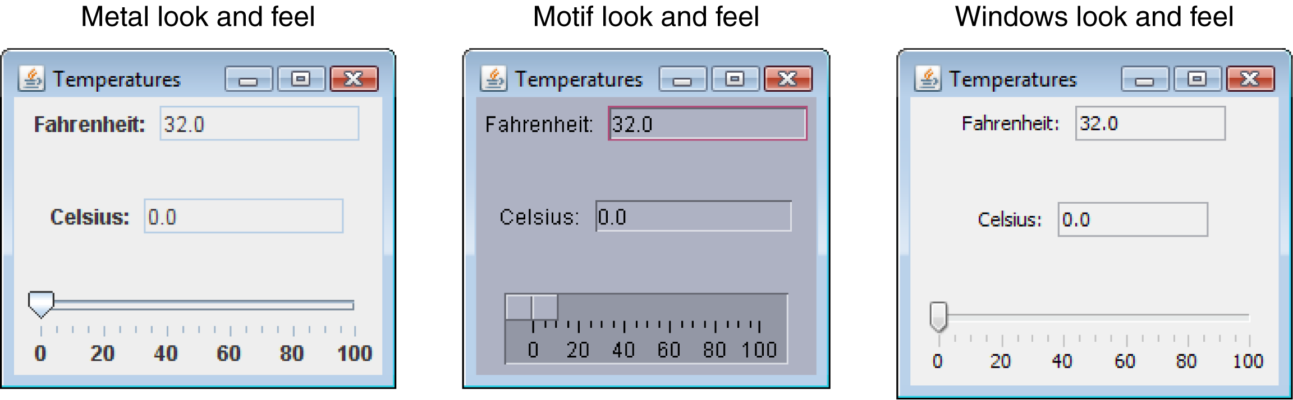
Look and Feel (4 of 7)

Slide 81
Look and Feel (5 of 7)
Any components that have already been created need to be updated.
SwingUtilities.updateComponentTreeUI(…);
This method takes a reference to the component that you want to update as an argument.
The UIManager.setLookAndFeel method throws a number of exceptions:
ClassNotFoundException
InstantiationException
IllegalAccessException
UnsupportedLookAndFeelException

Slide 82
Look and Feel (6 of 7)
Example (Motif):
try
{
UIManager.setLookAndFeel(
"com.sun.java.swing.plaf.motif.MotifLookAndFeel");
SwingUtilities.updateComponentTreeUI(this);
}
catch (Exception e)
{
JOptionPane.showMessageDialog(null,
"Error setting the look and feel.");
System.exit(0);
}

Slide 83
Look and Feel (7 of 7)
Example (Windows):
try
{
UIManager.setLookAndFeel( "com.sun.java.swing.plaf.windows.WindowsLookAndFe el");
SwingUtilities.updateComponentTreeUI(this);
}
catch (Exception e)
{
JOptionPane.showMessageDialog(null,
"Error setting the look and feel.");
System.exit(0);
}

